Slide 1

WORK INTEGRATED LEARNING • GROUP PRESENTATION
NEXT LEVEL GAMING & ESPORTS ARENA
Website & Mobile Application Project
Lethabo Mmako • Blessing Lethwane • Ramosoane Madileng
27 October 2026 | XHAW5112
01
Notes:
Opening: introduce the group and project. Aim for 45 seconds.

Slide 2
NEXT LEVEL • WIL PRESENTATION
Our project & client requirements
• Client: Jason Naidoo, founder of a Johannesburg-based gaming and esports arena.
• The arena serves casual gamers, competitive players, schools and corporate clients.
• Goal: a modern website and mobile app to explore packages, events and quotations.
• Key functions: package details, multi-booking discounts and contact information.
02
Notes:
Team member 1: Explain the client problem and who the platform serves. 1 minute.

Slide 3
NEXT LEVEL • WIL PRESENTATION
Why we chose these designs
• Dark charcoal background makes the neon colours stand out.
• Neon blue and purple reflect technology, gaming and esports energy.
• Clear headings, package cards and buttons help users find information quickly.
• Desktop: top navigation and responsive grid. Mobile: single-column content and bottom navigation.
03
Notes:
Team member 1: Explain visual hierarchy and user-centred design. 1 minute.

Slide 4
NEXT LEVEL • WIL PRESENTATION
Our logo & brand identity
• Controller silhouette immediately represents gaming.
• The letters N and L identify Next Level.
• Angular lines and neon glow suggest movement and competition.
• Recognisable on the website, mobile screens and promotional material.
04
Notes:
Team member 3: Point at the real project logo. Explain why it was selected. 1 minute.

Slide 5
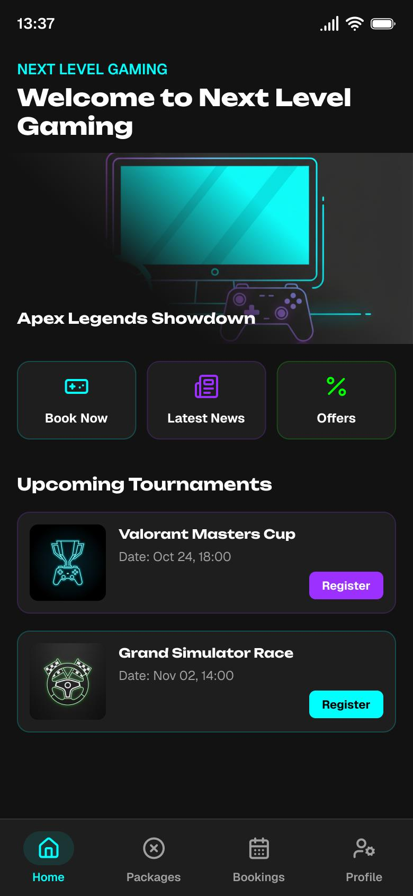
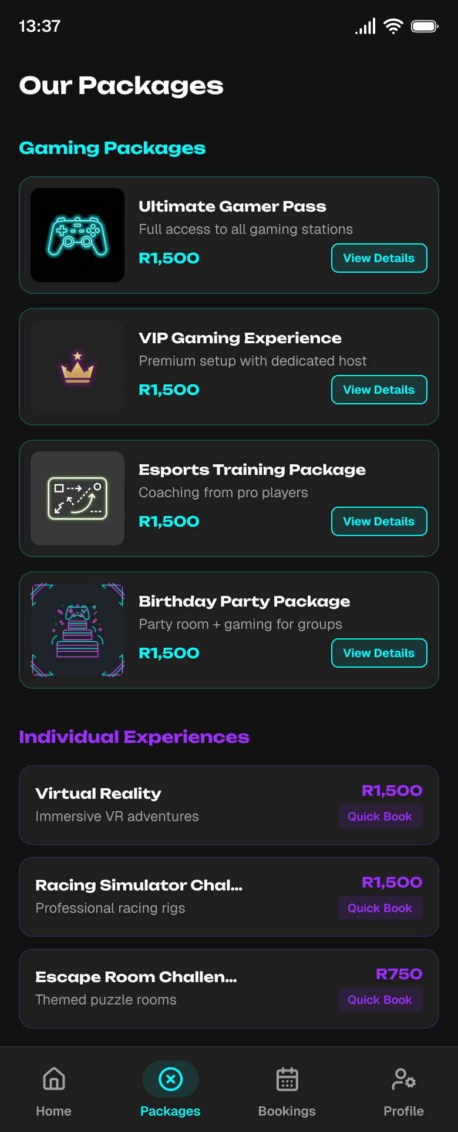
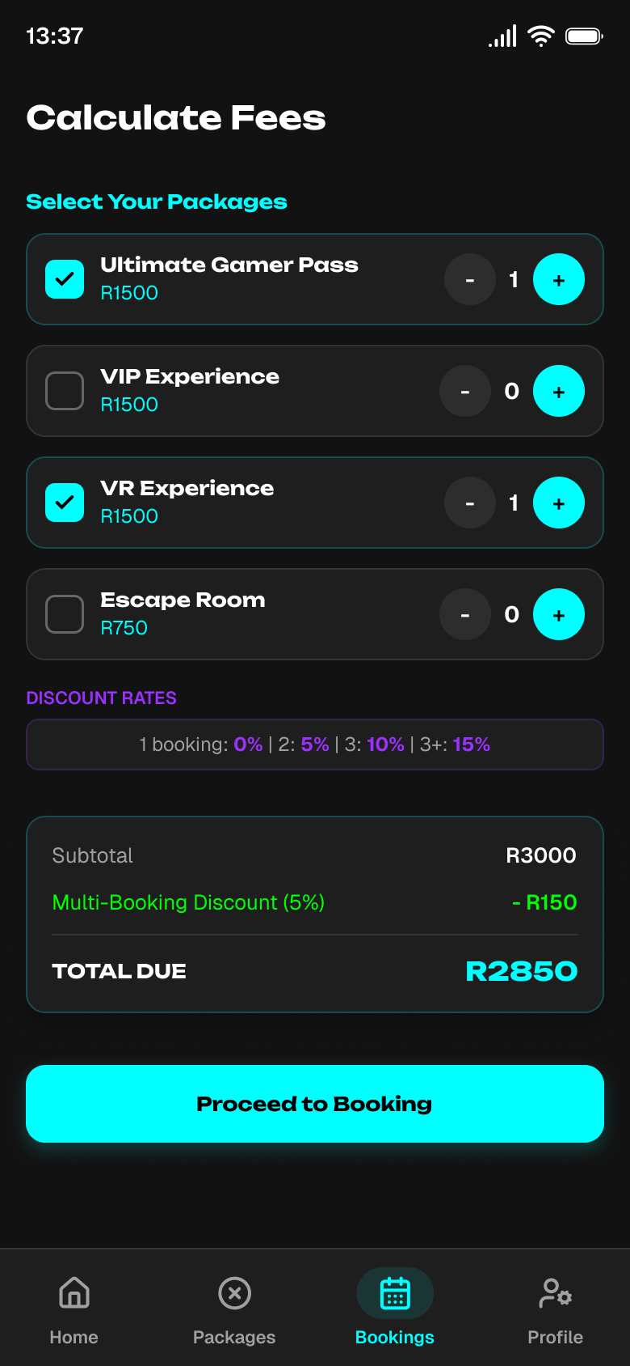
NEXT LEVEL • WIL PRESENTATION
From low-fidelity to high-fidelity wireframes
These are screenshots from our submitted wireframe document.
HOME
PACKAGES
FEES
05
Notes:
Team member 3: Explain wireframes as plans of screen layout and user journeys. Show Home, Packages, and Fees. 1.5 minutes.

Slide 6
NEXT LEVEL • WIL PRESENTATION
Wireframe screen purposes
• Home: featured packages, tournaments and quick actions.
• About Us: story, mission, vision and target customers.
• Packages + Details: compare offers and view what is included.
• Calculate Fees: choose quantities, apply discounts and see a quote.
• Contact Us: enquiry form and arena contact information.
06
Notes:
Team member 3: Walk through the user journey in about 1 minute.

Slide 7
NEXT LEVEL • WIL PRESENTATION
How our group worked together
• Lethabo Mmako — project manager and website frontend developer.
• Blessing Lethwane — UI/UX designer, wireframes and prototypes.
• Ramosoane Madileng — React Native mobile developer and testing.
• We coordinated through WhatsApp, Microsoft Teams, email and GitHub.
• GitHub branches and Trello helped organise code changes and tasks.
07
Notes:
Each group member briefly states their contribution. 1 minute.

Slide 8
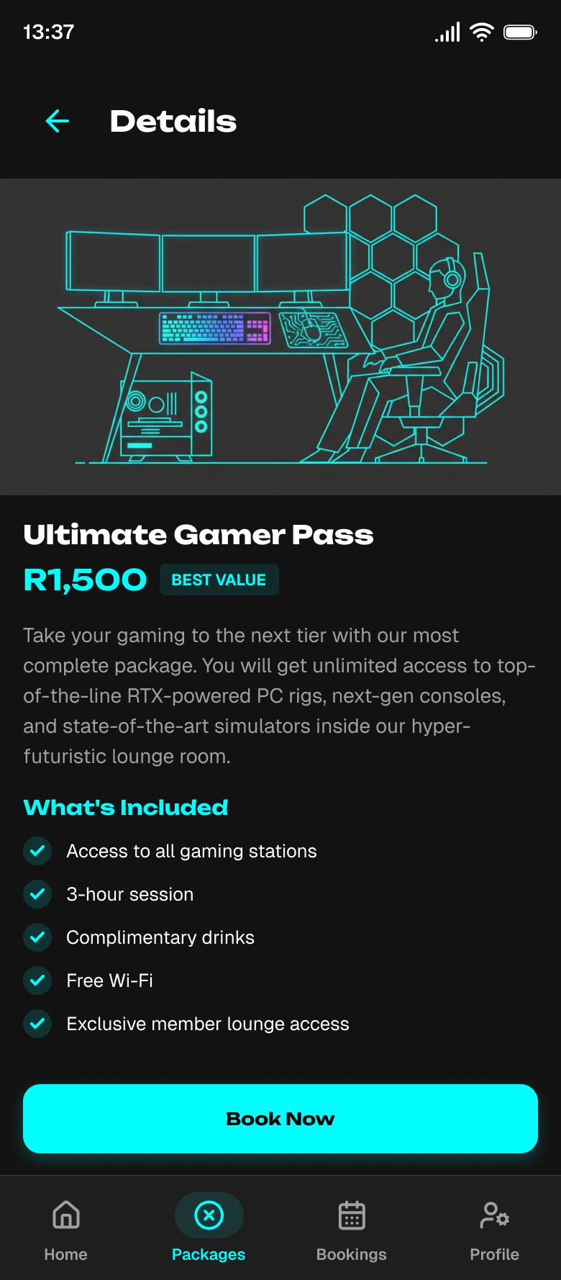
NEXT LEVEL • WIL PRESENTATION
Mobile app: implementation & features
• Built with React Native and Expo.
• Home, About, Packages, Package Details, Calculator and Contact screens.
• Tab navigation for main pages; stack navigation for package details.
• Shared data supports packages, tournaments and fee calculations.
08
Notes:
Team member 2: Explain the app then open the actual app if available. 1 minute.

Slide 9
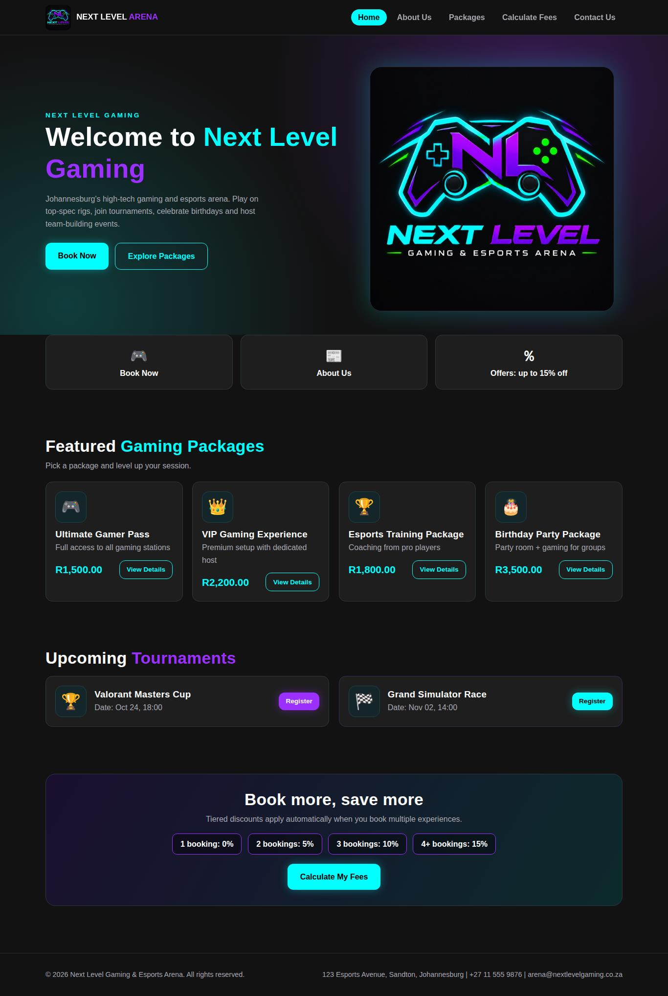
NEXT LEVEL • WIL PRESENTATION
Website: pages & responsive design
• HTML5, CSS3 and JavaScript.
• Six pages: Home, About, Packages, Package Details, Calculator and Contact.
• Desktop layout uses a sticky top navigation bar.
• Responsive grid adapts to narrow mobile screens.
09
Notes:
Team member 2: Show the real website running in browser. 1 minute.

Slide 10
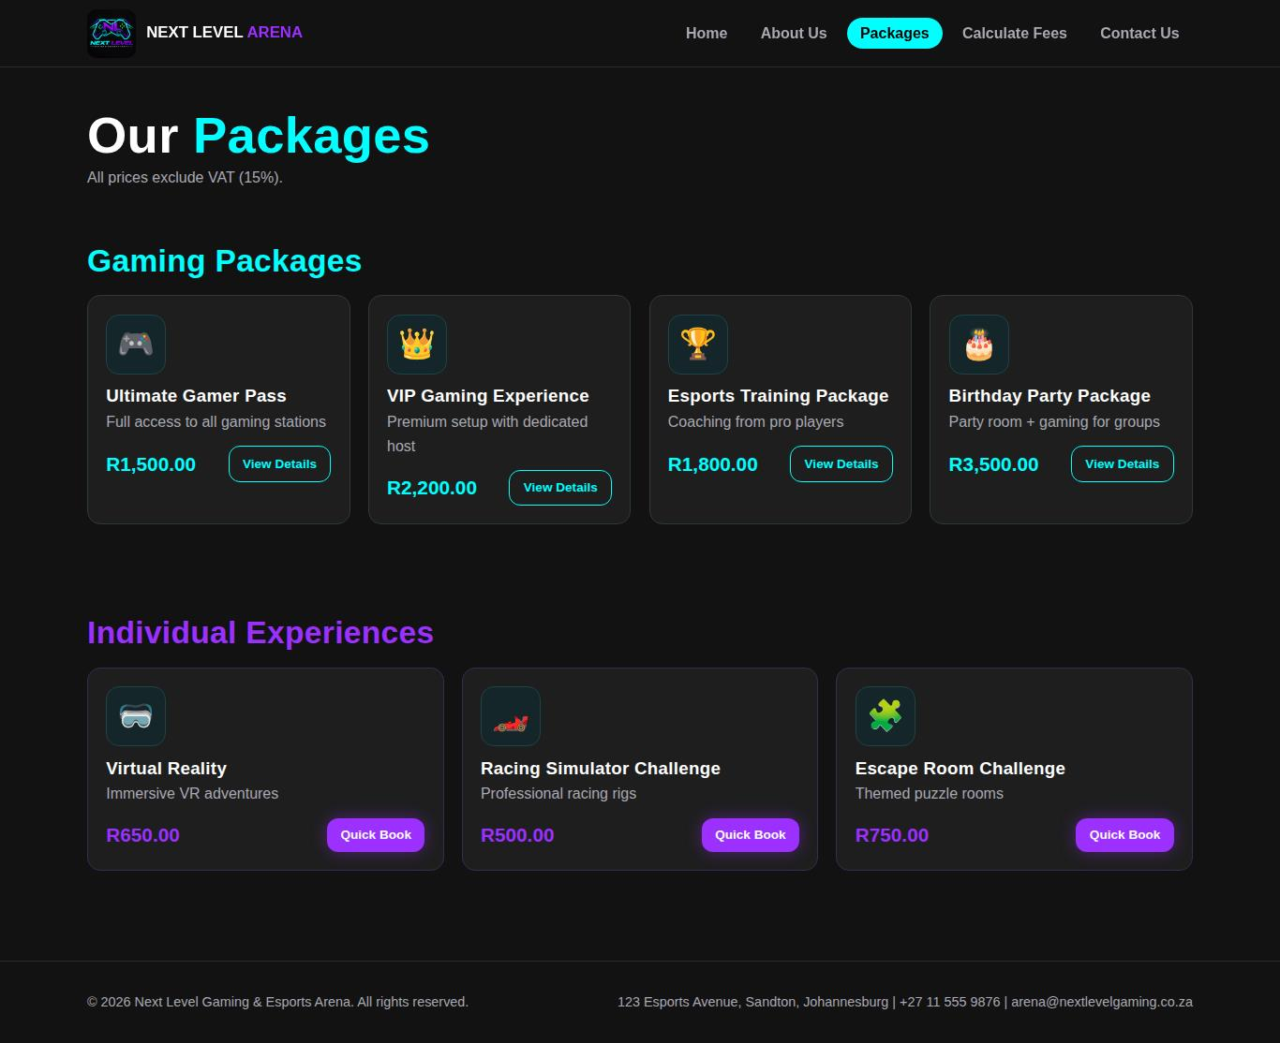
NEXT LEVEL / DEMONSTRATION
Website walkthrough | Browse & compare
Screenshots from Task 2 website pages — prepared visual demonstration
What to explain
1. The home page introduces the arena.
2. Visitors can view featured packages and tournaments.
3. The Packages page lets them compare gaming experiences.
HOME
PACKAGES
NEXT LEVEL GAMING & ESPORTS ARENA
Notes:
Speaker: website demonstrator. 50–60 seconds. Say: "This is our website home page. It introduces Next Level Gaming and gives visitors fast access to packages and tournaments. On the packages page, customers can compare their options before booking." These screenshots are taken from the submitted report. If the local website is running, switch to it for a live walkthrough.

Slide 11
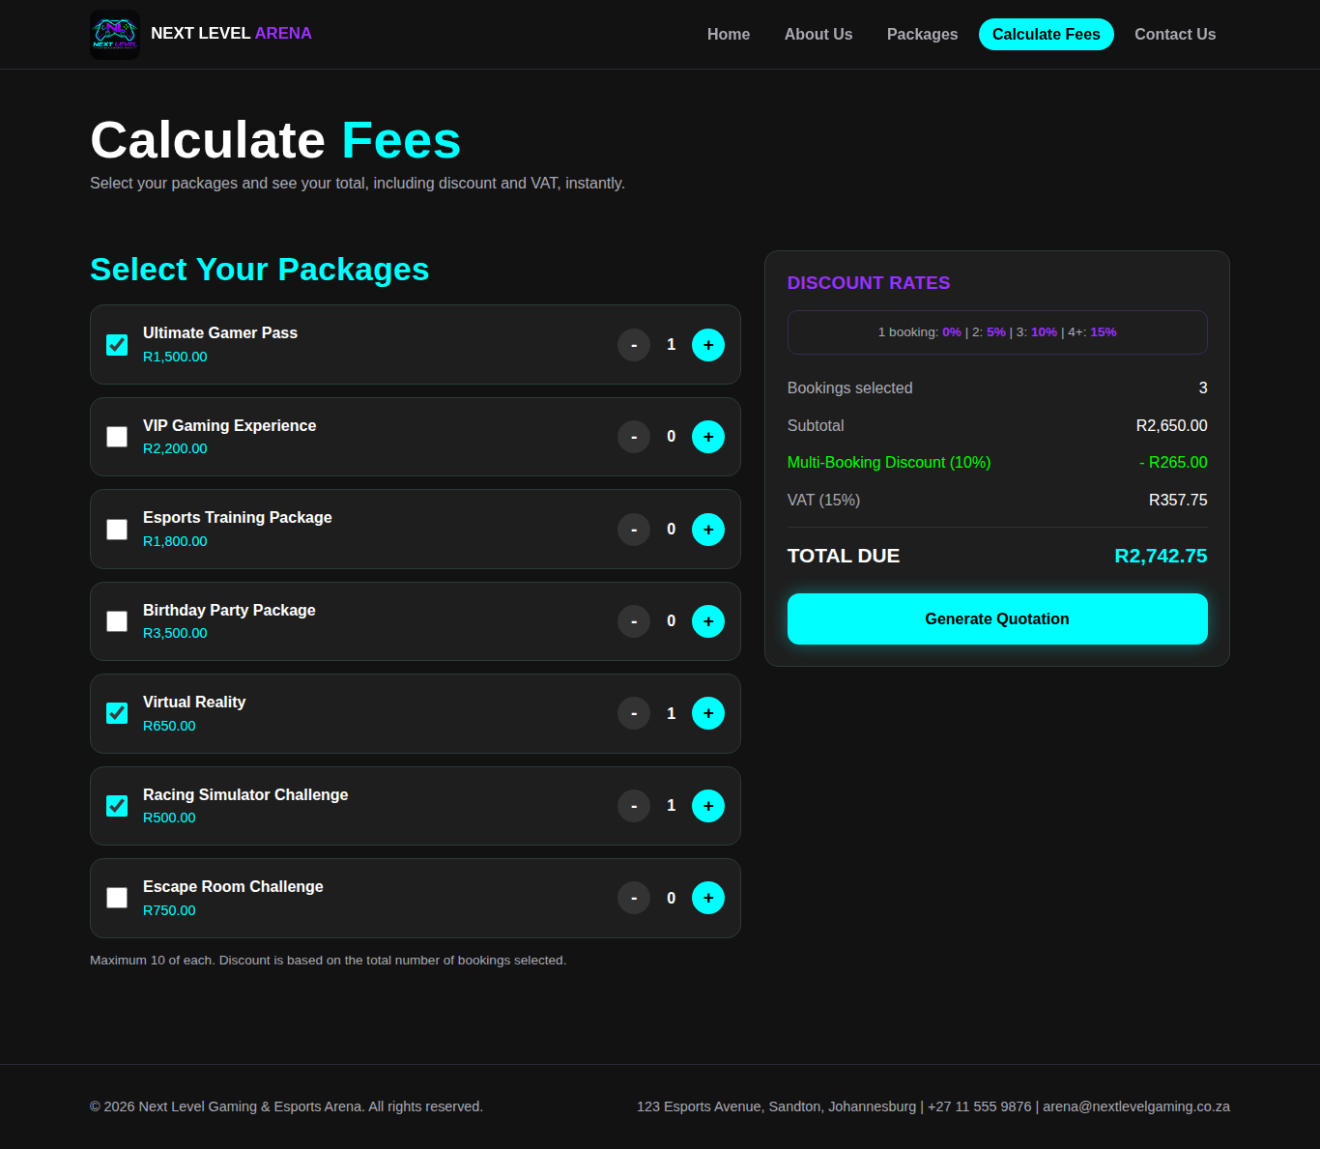
NEXT LEVEL / DEMONSTRATION
Website walkthrough | Calculate fees
Website calculator screenshot from Task 2 — explain the pricing steps
Customer journey
1. Select packages and quantities.
2. Apply the multi-booking discount.
3. Add 15% VAT after discount.
4. Show the final quotation.
Formula: (subtotal − discount) × 1.15
NEXT LEVEL GAMING & ESPORTS ARENA
Notes:
Speaker: website demonstrator. 1 minute. Explain that the number of bookings determines the discount (1=0%, 2=5%, 3=10%, 4 or more=15%). Then VAT is calculated after the discount. From Task 2 testing: R1500 + R650 = R2150; 5% discount R107.50; VAT R306.38; final total R2348.88. This screenshot provides visual support; for a functional demo, open calculator.html in your running website.

Slide 12
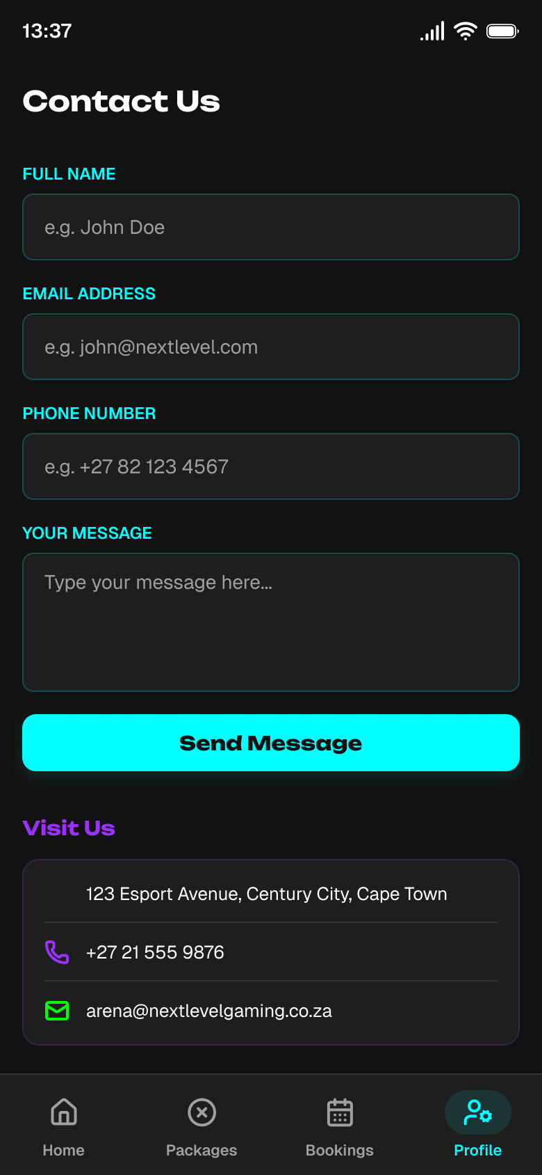
NEXT LEVEL / DEMONSTRATION
Mobile app walkthrough | Screen journey
Mobile design previews from the Phase 3 report — not a running app
HOME
PACKAGES
FEES
CONTACT
NEXT LEVEL GAMING & ESPORTS ARENA
Notes:
Speaker: mobile developer. 60–75 seconds. Clearly introduce these as mobile screen designs from the project design report. Walk through: Home promotes the arena and tournaments; Packages lists gaming options; Calculate Fees shows booking totals and discounts; Contact contains a form. If you have the app running in Expo Go, use it to demonstrate actual taps and calculations. Do not claim the design preview is proof the app ran.

Slide 13
NEXT LEVEL • WIL PRESENTATION
Calculator logic & testing
• Discount tiers: 1 booking = 0%; 2 = 5%; 3 = 10%; 4 or more = 15%.
• VAT: 15% added after the discount.
• Test: R1,500 + R650 = R2,150 subtotal.
• 5% discount = R107.50; VAT = R306.38; final total = R2,348.88.
• Website checked at 1366px desktop and 390px mobile widths.
13
Notes:
Explain why the discount is applied before VAT. The high-fidelity wireframe shown in Task 1 may omit VAT; Task 2 documents the VAT implementation. 1 minute.

Slide 14
NEXT LEVEL • WIL PRESENTATION
Progress, remaining work & conclusion
• Completed: branding, wireframes, core mobile app screens and website HTML pages.
• Tested: quotation calculation, responsive layouts and form validation rules.
• Remaining work identified in Task 2: polish, photography, map, accessibility testing and GitHub Pages deployment.
• Our solution provides a consistent experience for browsing gaming packages on web and mobile.
14
Notes:
Team member 1 or group: Conclude in 45 seconds. Do not claim deployment is complete.

Slide 15
NEXT LEVEL • WIL PRESENTATION
References — Harvard style
Figma (2026) Figma design tool. Available at:https://www.figma.com/design/6jIPelv1mDI1LIWjoFn7V3/Untitled?node-id=39-2&t=TWrmj1rX40UdcPa8-1
GitHub, Inc. (2026). GitHub. Available at: mosesthegreat555-ceaser/Next-Level-Gaming-Esports-Arena (Accessed: 9 October 2026).
Madileng, R.K. (2026) Next Level Gaming & Esports Arena: XHAW5112 Task 2. Unpublished student project report.
Microsoft Corporation (2026) Visual Studio Code. Available at: https://code.visualstudio.com/ (Accessed: 9 October 2026).
Mmako, L. (2026) Next Level Gaming & Esports Arena: Task 1, Phases 1–3. Unpublished student project reports.
Norman, D.A. (2013) The design of everyday things: Revised and expanded edition. New York: Basic Books.
Sources: submitted Task 1 and Task 2 project reports and the tools cited in those reports.
15
Notes:
References are shown in Harvard style. This slide can be displayed briefly before the concluding thank-you slide. Full sources are listed for academic attribution.

Slide 16
NEXT LEVEL • WIL PRESENTATION
Thank you — questions?
NEXT LEVEL GAMING & ESPORTS ARENA
Project materials: Task 1 Phases 1–3 and XHAW Task 2
16
Notes:
Close and invite questions. Total planned presentation approximately 12–14 minutes.

